Slide 1
The International Criminal Court
Marcus Wagemakers, counsel at the international criminal court | conseil auprès de la cour pénale internationale
Rotary, 23 May 2017

Slide 2
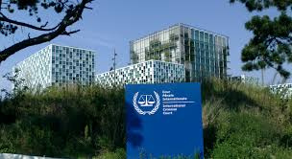
What is the international criminal court?
A permanent international court created to investigate, prosecute and try individuals alleged of commiting crimes to the international community.

Slide 3
Short fact list
Located in the Hague, The Netherlands;
Court of last resort;
Not a part of the United Nations system; the ICC is a self regulatory body
Mandate:
Rome Statute, adopted 17 July 1998, entered into force 1 july 2002

Slide 4
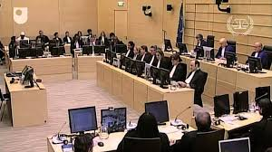
How the ICC intervenes
A situation can be referred to the Prosecutor by (i) the UN Security Council and/or (ii) a State Party; The Prosecuter is obliged to initiate an investigation;
The Prosecutor may launch an investigation
proprio muto; on the basis of information
(otherwise received)
Rome Statute art. 15 (1)

Slide 5
Criterion of a reasonable basis
The Prosecutor can deny an investigation if he determines that there is no reasonable basis to proceed.
Criterion:
Existence of a sensible or reasonable justification for a belief that a crime falling within the jurisdiction of the court has been or is being committed
Pre trial chamber Situation in the Republic of Kenya (ICC-01/09)

Slide 6
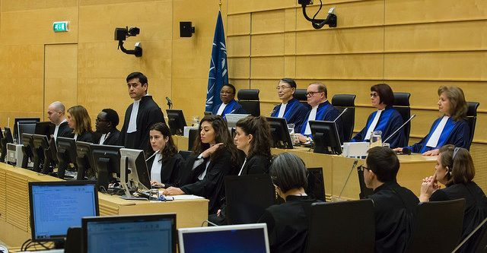
The ICC:
investigates
prosecutes; and
tries
suspects of genocide, crimes against humanity, war crimes and crimes of aggression ONLY when national authorities are unable or unwilling to do so

Slide 7
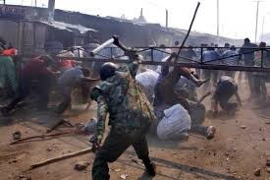
Prosecution focus is on major perpetrators
The ICC prosecutes individuals, not groups or states. Any individual who is alleged committed crimes within the jurisdiction of the ICC may be brought before the ICC.
Focus is on those who bear the greatest resposibility for the alleged crimes.

Slide 8
Serious international crimes
Genocide: intention to destroy al or part of a national , ethnic racial or religious group as such
Crimes against humanity: widespread systematic attack on any civilian population
War crimes: breach of Geneva Conventions/laws and customs of armed conflict
Crimes of Aggression: includes among others invasion, military occupation and annexation by the use of force, blockade of the ports or coasts if it is considered being a manifest violation of the Carter of the United Nations

Slide 9
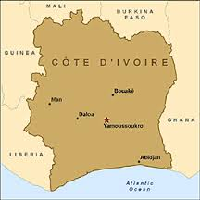
Cote d’Ivoire situation
Doc shadow work
https://www.youtube.com/watch?v=l6XQiF-avHs

Slide 10
Dealing with international crimes
After WW II: International Military Tribunals: Nuremberg/Tokyo
Ad Hoc Tribunals established by United Nations Security Council: ICTY/ICTR
Internationalized courts based on bi lateral treaties/agreements between the UN and the relevant country: Sierra Leone, Cambodia, East Timor, Lebanon
Permanent Court established by Treaty: the ICC

Slide 11
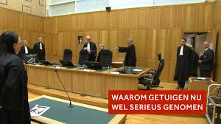
National Courts
Recently: ‘s-Hertogenbosch Appeals Court, the Netherlands: aiding and abbeting warcrimes in Liberia and Guinnee; 19 years impridsonment

Slide 12
Current ICC cases
Preliminairy investigations: Afghanistan, Burundi, Colombia, Gabon, Guinea, Iraq/UK, Nigeria, Palestine, Ukraine
Under investigation: Uganda, DRC, Darfur/Sudan, CAR, Kenya, Libya, Cote d’Ivoire, Mali, CAR II, Georgia
Cases: CAR, Cote d’Ivoire, Darfur/Sudan, DRC, Kenya, Libya, Mali, Uganda

Slide 13
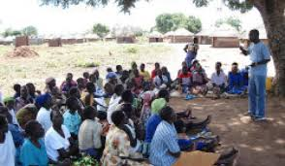
Victims participation
A victim is a person who has suffered harm as a result of the commission of a crime within the ICC’s jurisdiction

Slide 14
Victims participation
Unique: Victims can participate in the proceedings, independently of the prosecutions office or defence.
Victims have the right to their own legal representative in the courtroom
Trust fund for victims

Slide 15
Witnesses
ICC’s Victims and Witnessess Unit
Protective measures, including operational protective measures
ICC Witness Protection Programme

Slide 16
Thank you
marcus@mwagemakers.nl

